Slide 1
Introductory General Chemistry
Chemistry 3A
S. M. Halloran

Slide 2
Lewis Structures: The Octet Rule
Showing Lewis Structures in Covalent Molecules
The Shapes of Molecules
Electronegativity & Polarity
Interacting Forces Between Molecules: Dispersion, Dipole-Dipole, Hydrogen Bonding

Slide 3
Review of Periodic Table Patterns
The periods of the Periodic Table show a pattern of 2 elements in 1st period, then 8 elements in the 2nd and 3rd periods. (The 4th & 5th have 18 each, then the 6th & 7th have 32 each)
But it’s the elements of the 2nd & 3rd periods, particularly the 2nd, that strongly interest us.
On the left side of PT, the metal elements want to lose electrons to become POSITIVELY ionized (as cations). They have only 1, 2, maybe 3 electrons in their valence (outermost) shell that they give up in a true ionization of the atom.

Slide 4
Review of Periodic Table Patterns
The electrons given up readily by the metal elements in the Groups 1 and 2 are taken by the Group 16 and 17 non-metal elements on the other (right) side of the Table, which want those electrons to become negatively charged ions (anions)
This is all about stability, achieving the lowest energy state. It is about atoms ordering electrons in their orbits in an effort to become like the noble gas Group 18 elements

Slide 5
Review of Periodic Table Patterns
For Period 2 elements
Li and Be will lose 1 and 2 electrons, respectively, to become Li⁺ and Be²+, adopting a closed shell configuration looking like He, with its “duet” (2-electron) valence shell
On right side of table, F and O will acquire 1 or 2 electrons, respectively, to become F⁻ and O²⁻, adopting a closed shell configuration looking like Ne, with its “octet” (8-electron) valence shell
For Period 3 elements
Na and Mg will lose 1 and 2 electrons, respectively, to become Na⁺ and Mg²+, adopting a closed shell configuration looking like Ne, and “octet” valence shell
On right side of table, Cl and S will acquire 1 or 2 electrons, respectively, to become Cl⁻ and S²⁻, adopting a closed shell configuration looking like Ar, with its “octet” valence shell

Slide 6
The Octet Rule (Ions)
The octet name refers to particularly to atoms wanting to have a valence shell of 8 electrons that makes them look like the closest noble gas element
For elements on the left side of table, they will lose electrons to be like the noble gas element of the previous period. They will become positively ionized (1+, 2+, …) in the process
For elements on the right side of table, they will gain electrons to be like the noble gas element of the current period. They will become negatively ionized (1-, 2-, …) in the process
This is the case for metals and non-metals which will form ions and become ionic compounds

Slide 7
The Octet Rule (Molecules)
But when non-metal atoms form bonds with each other, they do NOT gain or lose electrons in the way metal and non-metal atoms do in ionization
Instead, the non-metal atoms will create a valence shell of 8 electrons around them, but these 8 electrons are shared between the atoms

Slide 8
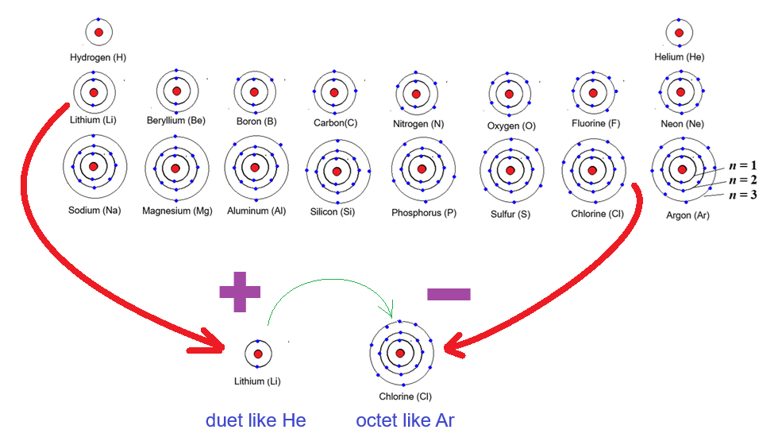
Wanting To Be Like Noble Gas Elements
Forming the octet (or duet) by ionization, to be an ionic compound

Slide 9
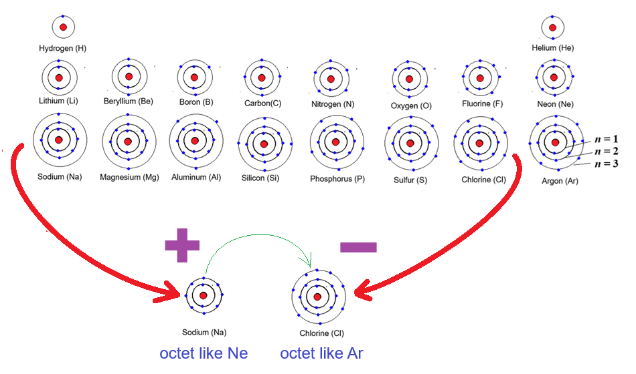
Wanting To Be Like Noble Gas Elements
Forming the octet by ionization, to be an ionic compound

Slide 10
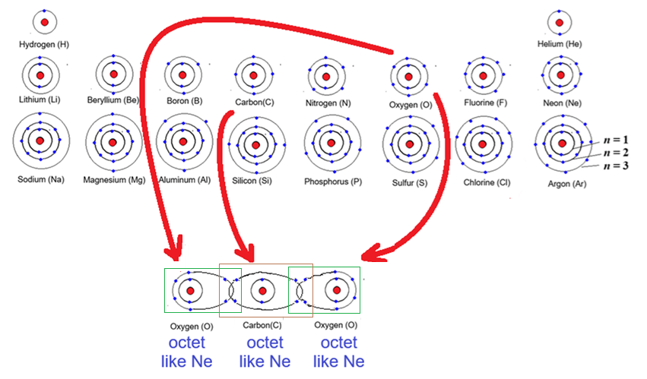
Wanting To Be Like Noble Gas Elements
Forming the octet through covalent bonding, or sharing.
The boxes count 8 electrons in valence (outermost) shells
Count them!

Slide 11
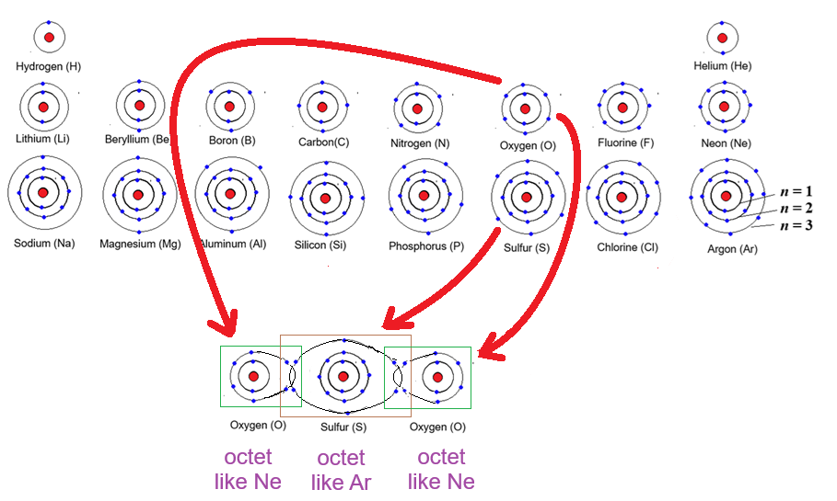
Wanting To Be Like Noble Gas Elements
Forming the octet through covalent bonding, or sharing.
The boxes count 8 electrons in valence (outermost) shells
Count them!

Slide 12
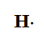
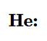
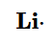
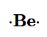
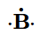
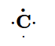
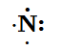
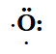
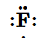
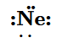
Electron Dot Diagramming
Lewis structures are the presentation of atoms with their valence (outermost shell of) electrons represented as dots
The dots can be placed around the element symbol top, right, bottom, left
The purpose of these diagrams are as an aid to chemists in showing the electrons available for BONDING of atoms to each other

Slide 13
Formation of Ionic Compounds
Sodium (Na) in Group 1 has 1 valence (outermost shell) electron. Getting rid of it will make it have the octet of the noble gas element of the previous period, neon (Ne). This provides an energy stability to sodium. It will become a +1 positive ion, so will be attracted to -1 negative ions.
Chlorine (Cl) in Group 17 has 7 valence electrons. If it just adds one more electron to that valence shell, it will have the octet of the noble gas element of its period, argon (Ar), providing energy stability to chlorine. It will become a -1 negative ion, so will be attracted to +1 positive ions
Sodium and chlorine thus form ionic compounds with each other
Ionic compounds are formed by bonds that are based on positive and negative electric charge points

Slide 14
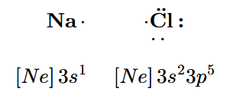
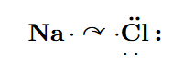
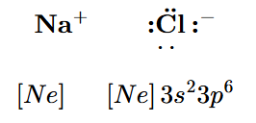
Lewis Structures of Ionic Compounds
Initially the Lewis structures show the atoms with their natural number of valence electrons, having zero charge
For sodium (Na), there is 1 valence electron (dot). For chlorine (Cl), there are 7 electrons (dots)
Note the electron configurations: Na⁰ has its valence shell at n = 3. Cl⁰ in same period has its valence shell at n = 3 too. (the n value is just a coincidence)
An electron moves from Na to Cl → Na⁺ and Cl⁻ form
Na⁺ has electron configuration of Ne now. [Ne] is also [He]2s²2p⁶, and Cl⁻ has configuration of [Ar], which is actually [Ne]3s²3p^{6.}

Slide 15
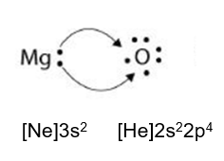
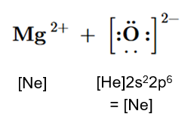
Two Electrons Moved
Group 2 element magnesium (Mg) has two electrons in its valence shell. Note the Lewis structure and the electron configuration of Mg⁰
Group 16 element oxygen (O) has six electrons in its valence shell. See its Lewis structure and electron configuration of O⁰
Mg willingly gives its two electrons, which O willingly takes
The Mg²⁺ ion now has the octet structure of the previous period noble gas, and O²⁻ has the structure of the noble gas element of its period

Slide 16
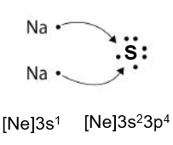
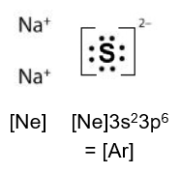
Two Electrons Moved, But FROM Two Atoms
Sulfur, in same Group 16 as oxygen, but one period down, is ready to take two electrons into its valence shell with 6 electrons, to complete the octet
It is not required that it be from a Group 2 element with two electrons. Instead it can be two Group 1 elements, like potassium (K) or lithium (Li), but in this case sodium (Na) again
Note the resulting electron configurations and Lewis structures

Slide 17
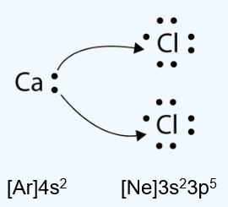
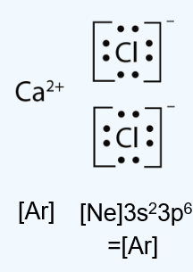
Two Electrons Moved, But TO Two Atoms
This diagramming just demonstrates how the two valence shell electrons of calcium (Ca) in Ca⁰ where one each is used to add one electron to each of two chlorine (Cl) atoms in the Cl⁰ state
The result is a Ca²⁺ ion, two Cl⁻ ions, and these will be the formula unit of ionic compound solid/crystal that is the compound
Note how the electron configurations of the ions in the compound show how they form the octet of a noble gas element

Slide 18
Summarizing Ionic Compound Lewis Structures
Lewis structures are dot diagrams of atoms where the dots around the atom represent the valence (outermost) shell of electrons
Electrons are involved in bonding. Bonding of the ionic type is where one atom fully takes the electron(s) of another atom, and the resulting electric (positive and negative) charges are what creates the bond (attraction), a strong force keeping the atoms close to each other
Start with a Lewis structure of the neutral (zero-charge, non-ionized) atom with its proper number of electrons; then move the dots (electrons) as they interact with other atoms

Slide 19
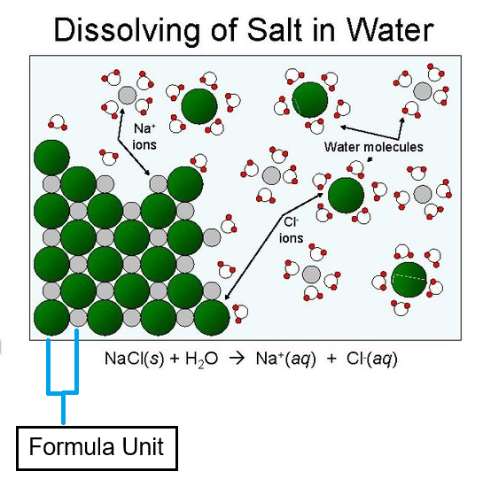
More Detail on Formula Unit
The formula unit describes an ionic compound (salt) in the solid phase
It is the smallest, electrically neutral ratio of ions in a 3-dimensional crystal lattice
Unlike a molecule, it is NOT a distinct independent particle
The formula unit does NOT describe solvated ions (ions in the aqueous phase)

Slide 20
Lewis Structures of Covalent Compounds
Ionic compounds represent one end of a spectrum of chemical bonding
Covalent compounds—where atoms bond by the sharing of electron pairs—electron pairs make up bonds—represent another end of that chemical bonding spectrum
It must be re-emphasized that these covalent compounds will typically point to the bonds between nonmetal elements
Determination of Lewis structures will follow a specific set of rules to be detailed on slides that follow

Slide 21
Lewis Structures of Covalent Compounds
Determine total number of valence shell electrons in the molecule/ion
Add the electrons from each atom
OF₂: 6 e⁻ from O atom, 7 e⁻ from F 6 + 2 × 7 = 20 e⁻
If species is polyatomic ION, be sure to add or subtract electrons that give the ion its charge
CO₃²⁻: 4 e⁻ from C atom, 6 e⁻ from O, 2 e⁻ from charge 4 + 3 × 6 + 2 = 24 e⁻

Slide 22
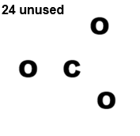
Lewis Structures of Covalent Compounds
Arrange atoms to show their specific bonding
There is usually one atom in a polyatomic compound that is a central atom, or the atom to which other atoms are bonded to
For example, in CO₃²⁻ or CCl₄, this will be the carbon (C) atom
For an atom like hydrogen (H), it would never be a central atom (instead it is a terminal atom, at the terminus of a bonding series)

Slide 23
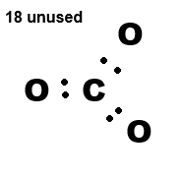
Lewis Structures of Covalent Compounds
Put a bonding pair of electrons between all the atoms
A single bond between atoms uses two electrons (orbital pair)
For atoms in a molecule/polyatomic ion to be connected or bonded to each other, there must be at minimum a single bond between them

Slide 24
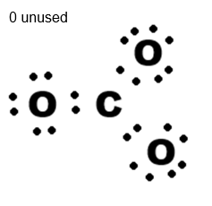
Lewis Structures of Covalent Compounds
For the terminal atoms (like oxygen, O), use the remaining electrons to create a total of 8 electrons (the octet) surrounding the atom
Arrange the electrons so they have a paired look!
Note the nonbonded LONE PAIRS in the atoms!
Do not put an octet for hydrogen (H): it only has
a duet for its valence shell

Slide 25
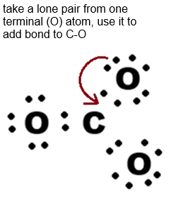
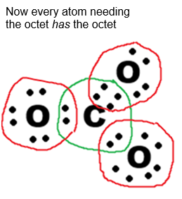
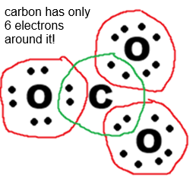
Lewis Structures of Covalent Compounds
Leftover electrons are placed on the central atom
Now check the central atom: does it have an octet of electrons around it? If NOT, then move lone pairs from other atoms to form double- and triple-bonds between central and terminal atoms to make an octet

Slide 26
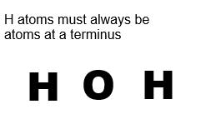
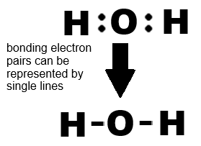
Let’s Do It Again: Water
# valence electrons = 2 H x 1 e⁻/H + 1 O x 6 e⁻/O = 8 e⁻
Arrange the atoms for central and terminus:
Now put at least one bonding pair between the atoms
Electrons used were 4; still have 4 left

Slide 27
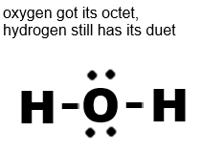
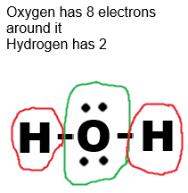
Let’s Do It Again: Water
Start with terminal atoms, add electrons to form an octet (only a duet for hydrogen [H])
There are only H atoms at termini, so these will have the duet
Leftover electrons get added to central atom
Oxygen (O) is central atom, and already has its electrons
The central atom should get its octet of electrons if it doesn’t have them, even to form double- or triple-bonds

Slide 28
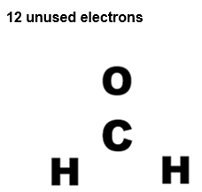
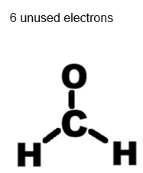
One more time: Formaldehyde (CH₂O)
# valence electrons = 2 H x 1 e⁻/H + 1 O x 6 e⁻/O + 1 C x 4e⁻/C = 12 e⁻
Arrange the atoms for central and terminus. Carbon (C) typically forms a central atom as in this case
Now show the single bond (electron pair) connections

Slide 29
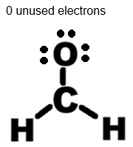
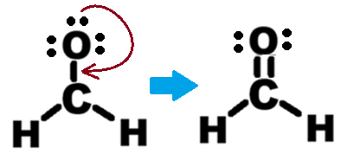
One more time: Formaldehyde (CH₂O)
Start with terminal atoms, add electrons to form an octet (only a duet for hydrogen [H])
There are two H atoms, one O atom
Leftover electrons get added to central atom
No leftover electrons for central C atom
The central atom should get its octet of electrons if it doesn’t have them, even to form double- or triple-bonds
Carbon (C) did not have its octet & needed a double bond

Slide 30
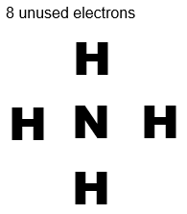
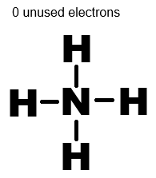
Polyatomic Ion Lewis Structure (NH₄⁺)
# valence electrons & charge state = 4 H x 1 e⁻/H + 1 N x 5 e⁻/O – 1 e⁻ [+1 state] = 8 e⁻
Arrange the atoms for central and terminus. In this case nitrogen (N) forms a central atom
Now show the single bond (electron pair) connections

Slide 31
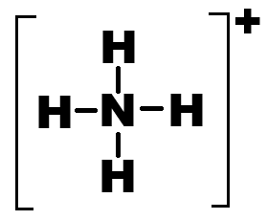
Polyatomic Ion Lewis Structure (NH₄⁺)
Start with terminal atoms, add electrons to form an octet (only a duet for hydrogen [H])
There are four H atoms, one N atom
Leftover electrons get added to central atom
No leftover electrons for central N atom
The central atom should get its octet of electrons if it doesn’t have them, even to form double- or triple-bonds
Not needed

Slide 32
Resonance
Go back to the slide on carbonate ion (CO₃²⁻)
It has 3 oxygen (O) atoms bonded to the central carbon (C) atom
In completing a proper Lewis structure, one of the oxygen atoms was selected to form a double bond while the other two oxygen atoms had no change to the bonding arrangement they had with carbon
So why weren’t the other oxygen atoms selected? Why couldn’t they be selected?

Slide 33
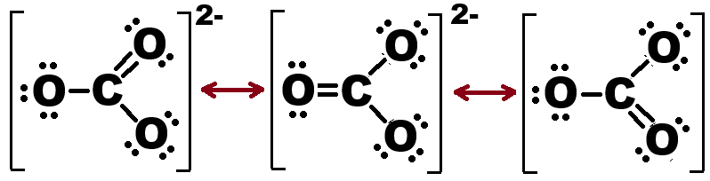
Resonance
In fact, any of the oxygens could be the one with the double bond to carbon
More importantly, it is thought that the double bond can “rotate” around the carbon atom and form and “unform” rapidly with all three oxygen atoms

Slide 34
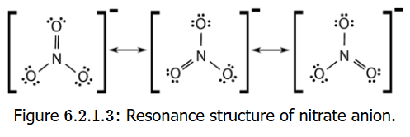
Resonance
Look at the structure of nitrate (NO₃⁻), and how similar it is to carbonate (CO₃²⁻), but with N as the central atom to three terminal O atoms
The double bond forms and “unforms” around all three O atoms
(Also note that the charge for NO₃ is -1 and for CO₃ it is -2: count the Lewis structure electrons to understand why)

Slide 35
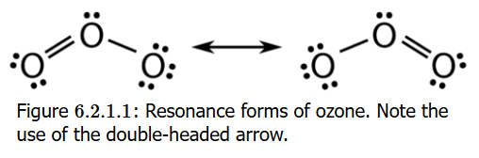
Resonance
Ozone (O₃) is three oxygen atoms bonded to each other
In building the Lewis structure for this, there are 18 total valence electrons: 6 each from the three oxygen atoms
When the rules are followed, a double bond will be formed between two of the O atoms, but not the third
Because two structures are possible, ozone shows resonance

Slide 36
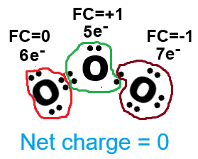
Formal Charge
We interrupt the resonance message to talk about another concept
In chemistry, formal charge is a hypothetical charge assigned to an atom in a molecule, assuming that the electrons in all chemical bonds are shared equally between the bonded atoms, regardless of their actual electronegativity*
Half of the electrons involved in bonds (single, double, triple) belong to one atom, the other half the other atom
All nonbonding (“lone pair”) electrons belong to one atom
Net charge = 0 + (+1) + (-1) = 0

Slide 37
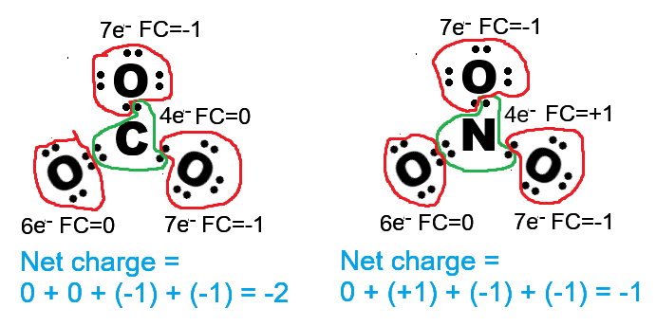
Formal Charge
You first need to understand how many valence electrons around an atom gives it ZERO charge
Carbon = 4, Nitrogen = 5, Oxygen = 6
If nitrogen has 4 electrons belonging to it, it is one short of 5, so its formal charge is +1
If oxygen has 7 electrons belonging to it, that is one more than 6, so its formal charge is -1
Add up all atom formal charges to get the NET charge on molecule

Slide 38
Resonance Observation
Let’s get back to resonance. Ozone can have one of two (Lewis) structures
Bonds between atoms have lengths. It is fact that double bonds create a shorter length (shorter distance between atoms) than single bonds and chemists have ways of determining bond length
So chemists should see the central O atom shorter in a terminal O atom than the other
But this is not found. The bond lengths are equal
Let’s go from observation → hypothesis → experiment → theory

Slide 39
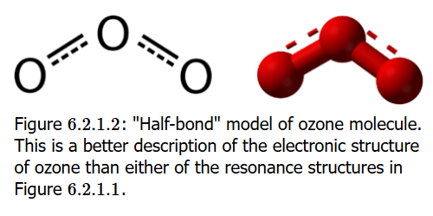
Resonance Theory
If terminal O atoms are equal distance from central O atom, then the two electrons that create the double bond must be delocalized across the whole molecule. (Localized means the bonding electrons would not be “spread out” across the molecule but confined between two atoms)
This is called a half-bond model in explaining resonance

Slide 40
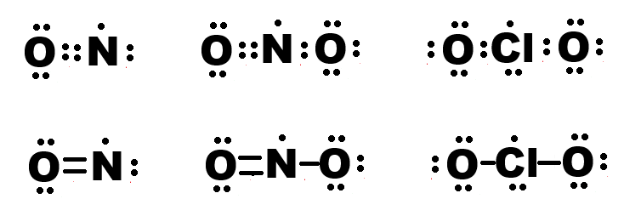
Octet Rule Exceptions
Usually electrons want to exist as pairs in orbitals
This is their more stable configuration
But there are molecules that are semi-stable with an odd number of electrons: NO, NO₂, ClO₂

Slide 41
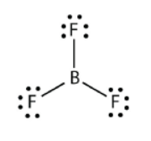
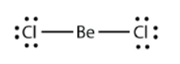
Octet Rule Exceptions
Electron-deficient molecules are another exception
Beryllium can have just a quartet (4 electrons) and boron can have just a sextet (6 electrons)
Another exception are atoms with MORE than octet: these are expanded valence shell but these are not covered in this course

Slide 42
Molecular Shape Prediction
All molecules have shapes, geometric characteristics
Electrons around atoms exist
in bonding pairs—connection between atoms
in nonbonding pairs (lone pairs)
Electrons are all negatively charged and want to repel from each other
This repulsion is what defines/contributes to bonded atoms creating space with each other in shaping the molecule

Slide 43
VSEPR
Two components to Valence Shell Electron Pair Repulsion
Electron Group Geometry: this about how groups of electrons (as bonding and nonbonding pairs) arrange from each other
ATOMS as bonding electron pairs whether single, double, triple bonds are one group
Nonbonding (lone) pairs are another group
Molecular Geometry: this looks at how atoms (not electron groups) arrange in a molecule

Slide 44



Geometry: Electron Group & Molecular
Molecule | Visual | Electron Group Geometry | Molecular Geometry
Methane (CH₄) |  | Tetrahedral | Tetrahedral
Ammonia (NH₃) |  | Tetrahedral | Trigonal Pyramidal
Water (H₂O) |  | Tetrahedral | Bent
Electron Group Geometry looks at atoms AND nonbonding (lone) pairs at the vertices
Molecular Geometry only looks at atoms at the vertices

Slide 45

Two-Terminal Group Molecules
Molecules with two terminal electron groups will be linear
Electron groups can be atoms or groups of atoms
The linear shape reflects groups wanting to maximize space

Slide 46


Three-Terminal Group Molecules
A trigonal molecule will usually be a FOUR-atom molecule, with a central atom and three terminal atoms or groups of atoms
The bond angles between the terminal atoms to the central atom will be a predictable 120° angle
All atoms are in ONE PLANE (“trigonal planar”)
Example: boron trifluoride -- BF₃
Note with central atom BORON as an exception to the octet rule, it has only 6 valence electrons (3 bonded pairs) and NO LONE (NONBONDING) electron pair, making this geometry possible

Slide 47

Three-Terminal Group Molecules
A trigonal molecule can be THREE atoms/electron groups: a nonbonding (lone) pair can create the trigonal geometry with the lone pair pushing by repulsion (VSEPR) the other two terminal atoms
The lone pair repulsion creates a “bent” or “angular” shape in the molecule
germanium difluoride -- GeF₂
Note the lone (nonbonding) pair on central germanium atom

Slide 48


Four-Terminal Group Molecules
A tetrahedral molecule will typically have FIVE atoms/electron groups with four terminal atom/electron groups around a central atom
This is a 3-dimensional geometry with the spacing between the bonds all angles being 109.5°

Slide 49

Four-Terminal Group Molecules
Examples of three types of 4-terminal electron groups shown below
Methane (CH₄) has four H atoms around a central C atom in tetrahedral arrangement
Ammonia (:NH₃) has three H atoms around a central N atom in trigonal pyramidal arrangement because of one lone pair
Water (H₂O::) has two H atoms around a central O atom in a bent arrangement because of two lone pairs

Slide 50



Four-Terminal Group Molecules
In Valence Shell Electron Pair Repulsion (VSEPR) theory nonbonding (lone) pairs appear to have a greater repulsive force than bonding pairs
Why?
Lone Pairs | Bond Angle
0 | 109.5°
1 | 107°
2 | 104.5°

Slide 51






Shape Summary
# of Electron Groups | Electron Group Geometry | Ideal Bond Angle | Molecular Geometry
 |  |  | 0 lone pairs | 1 lone pair | 2 lone pairs
2 | Linear | 180° | Linear
3 | Trigonal Planar | 120° | Trigonal Planar | Bent
4 | Tetrahedral | 109.5° | Tetrahedral | Trigonal Pyramidal | Bent

Slide 52
What’s the Shape?
What is shape of PCl₃? (phosphorus trichloride)
Draw Lewis structure Cl will have 3 lone pairs each (not contributing to shape)
P atom will have 3 terminal Cl atoms
One lone pair is on P atom
Shape: trigonal pyramidal
What is shape of NOF? (nitrosyl fluoride)
Central atom is N, terminal atoms are O and F
Lewis structure: N double bond O, N single bond F, two lone pairs on O atom, 3 lone pairs on F 1 lone on central N atoms → bent

Slide 53


What’s the Shape?
What is shape of CH₂Cl₂? (dichloromethane)
Lewis structure has central C atoms with four terminal atoms: two H atoms, two Cl atoms
No lone pairs on C or H, three lone pairs on Cl atoms which do not contribute to shape
Shape: tetrahedral
What is shape of C₂H₄? (ethylene)
Two central atoms of C
Terminal atoms of each are: two H atoms and one C atom (the other C)
Lewis structure: C single bond to both H atoms, double bond other C, no lone pairs
Shape: trigonal planar each C

Slide 54
Bond Polarity
On one side: ionic, other side: covalent
In the middle: partial sharing
better term: polar covalent
Despite sharing in covalent bonding of the nonmetal atoms, some of the atoms of nonmetal elements want electrons more than the other atoms of the nonmetal elements.
The atoms of elements forming bonds with electron pairs between them will likely differ in how much they are willing to share all pairs of electrons in the bonds they form between the atoms.

Slide 55
Electronegativity
Electronegativity is a property of every element in the Periodic Table
Electronegativity describes the potential of an atom to attract electrons when it is in a bond. The difference in electronegativity values between two atoms is what predicts the type of bond (ionic, polar covalent, covalent) that will form between them.
An element will have a HIGHER electronegativity if it wants the electrons (electron pairs) more
Metal elements on left side of Table will have LOWER electronegativities than nonmetal elements on right side
Flourine at upper right of Table has the highest electronegativity of any element

Slide 56

Electronegativity Values
Values show how much the atoms of element want to hold on to the electrons (electron pairs) in a bond

Slide 57
Standard for Bonding Polarity
For two bonded atoms, compute the difference in their electronegativity values → ΔEN
If the difference falls within the ranges in the table below, you can class the bond as nonpolar covalent, polar covalent, or ionic
ΔEN | Bond Type
ΔEN < 0.5 | Nonpolar covalent
0.5 ≤ ΔEN ≤2.0 | Polar covalent
ΔEN > 2.0 | Ionic

Slide 58

Nonpolar Covalent Bonds
Chlorine molecule (a gas), has structure Cl₂ (Cl-Cl)
The Cl atom electronegativity value is 3.0. The computed difference is ΔEN = 0. Thus it is a completely nonpolar covalent bond.
This makes sense that diatomic molecules would have no polar or ionic nature in bonds between them since atoms of identical type would have “equal pull” (attraction) for the electrons in any bond

Slide 59



Polar Covalent Bonds
Hydrofluoric acid (older name hydrogen fluoride) (HF) is a hydrogen (H) atom bonded with the most electronegative element, fluorine (F)
Electronegativities: H = 2.1, F = 4.0 ΔEN = 1.9 Polar covalent from the table. Chemists use delta+ (δ+) or delta- (δ-) or a dipole moment or dipole vector (the crossed arrow)

Slide 60
Understanding Bond Polarity
You understand bond polarity by using the element’s/atom’s electronegativity values
What is the polarity of the carbon-hydrogen bond (C—H)?
This may the most important chemical bond of all. It is fundamental bond in organic chemistry.
Electronegativities: C=2.5, H=2.1, ΔEN = 0.4, nonpolar covalent
What is the polarity of the oxygen-hydrogen bond (O—H)?
Another most important bond!
Electronegativities: O=3.5, H=2.1, ΔEN = 1.4, polar covalent

Slide 61
More Bond Polarity
What is the polarity of the rubidium-fluoride bond (RbF)?
Electronegativities: Na=0.9, Cl=3.0, ΔEN = 2.1, ionic
What is the polarity of the rubidium-fluoride bond (RbF)?
Electronegativities: Rb=0.8, F=4.0, ΔEN = 3.2, very ionic
What is polarity of the phosphorus-chloride bond (PCl)?
Electronegativities: P=2.1, Cl=3.0, ΔEN = 0.9, polar covalent

Slide 62
Molecular Polarity
In previous slides we talked about bond polarity
Here we talk about molecular polarity: is a molecule itself polar or nonpolar?
Nonpolar molecules/compounds
Usually symmetric: all sides around central atom identical
No unshared bonding electron pairs (extreme polarity)
Polar molecules/compounds
Usually asymmetric
Central atom has nonbonding (lone) pairs
Bonded atoms with high electronegativity differences
Must understand Lewis structures and VSEPR theory to make this assessment

Slide 63
Molecular Polarity
A molecule will be polar if it can be shown to have a dipole, where the electron density has an unequal distribution (see image)
The H-F molecule has a polar covalent bond, and this also made this molecule polar
Polarity in a molecule is indicated/suggested/symbolized by use of a lowercase delta (δ) with δ+ or δ– along molecule axis
It is also symbolized by a crossed-arrow, the cross point representing the positive charge end and arrow pointing to negative charge

Slide 64

Molecular Polarity
Start with Lewis structures to assess molecular polarity
Nonpolar compounds
Symmetric: sides around central atom identical
No unshared pair of electrons
Polar compounds
Asymmetric
Bonds in atoms have large differences in electronegativities
Presence of nonbonding lone pairs

Slide 65

Molecular Polarity
Overall molecular polarity will be a combination of the dipole moments of all the bonds between atoms in the molecule
Dipole moments (as vectors) will have a magnitude that reflects the electronegativity differences in each of the two atoms bonded, AND also the direction of the dipole moment, which is determined by molecular geometry or shape.
Note how nonpolar boron trifluoride and carbon tetrachloride have significant individual bond dipoles, but the direction of the bond dipole moments have the net molecular dipole moment of zero, so the molecule has no polarity overall.

Slide 66

Molecular Polarity Evaluation
With Lewis structures, you are especially looking for nonbonding (lone) pairs!
The electronegativity differences between atoms shows you BOND polarity (dipole moment) magnitudes
The shape/geometry will indicate individual bond polarity (dipole moment) directions, which can be “summed” to give overall molecular polarity (dipole moment) direction

Slide 67

Polar Molecule Properties
There are several properties that can be used to distinguish polar from nonpolar molecules
In an external electric (high voltage) field, polar molecules (image) will align directionally, and this might be observable in an instrument
Higher melting points for solids
Higher boiling points in liquids
Polar substances more soluble in water
Polar substances have lower vapor pressures (they resist going into gas phase, want to remain liquids)
All these show strong intermolecular attractive forces

Slide 68


Polar or Nonpolar?
Water: any molecule like H₂O with nonbonding (lone) pairs on the central atom (oxygen will be polar. Each O–H shows bond polarity, the overall direction of polarity of the angled bond showing a net dipole
Carbon dioxide: each C–O bond shows bond polarity (the O atom more electronegative), but because O=C=O is linear with the bond dipoles OPPOSING in direction, the molecule shows a net dipole of zero (nonpolar)

Slide 69


Polar or Nonpolar?
Methanol: the –OH group on central carbon creates an asymmetry in the molecule. The more electronegative O atom creates a net dipole toward the atom’s two nonbonding (lone) pairs. Molecule is polar.
Hydrogen cyanide: H–C bond polarity is toward more electronegative carbon, and there is an additive bond polarity in C–N bond toward nitrogen: polar

Slide 70


Polar or Nonpolar?
Diatomic oxygen: O₂ is not different than Cl₂ or any other symmetric diatomic molecule with respect showing no bond polarity at all, so the molecule likewise is nonpolar.
Propane: The molecule shows structural symmetry. While there is bond polarity for all the H–C bonds, the sum of the bond dipole vectors adds up to a net molecule dipole moment (which is vector quantity) of zero. Molecule is nonpolar

Slide 71


Polar or Nonpolar?
Sulfur trioxide: The three S–O bonds in SO₃ show bond polarity, but because the molecule as a whole shows trigonal planar symmetry The net dipole moment is zero, so the molecule is nonpolar
Ammonia: The three N–H bonds show significant bond polarity. And the nitrogen with its lone pair provides significant molecular polarity. Molecule is polar

Slide 72
Intermolecular Forces
Intramolecular (“within molecule”) forces generally describe the bonds that connect atoms inside a compound/molecule. The energies affecting these bond are considerable: 927 kJ to break O–H bonds per mol H₂O.
Intermolecular (“between molecule”) forces describe the forces or “bonds/bonding” that affect molecules with other molecules, but are much weaker than intramolecular. Energy to put H₂O molecules from liquid to vapor phase is 41 kJ per mol at 100°C. Covalent bonds are not broken in this process
Note that while liquids resemble solids more than gases

Slide 73
Intermolecular Forces
Observable properties of intermolecular forces include melting points of solids, boiling points of liquids
The nature of intermolecular forces is electrostatic: meaning positive and negative charges create attractive interactions
But these forces weaken at larger distances between molecules
So the forces are stronger in solids and liquids, less so with gases
But when gases become dense (liquid-like), these forces increase

Slide 74

Dipole-Dipole Interactions
In polar covalent bonds, there is a dipole because of electronegativity differences between the bonded atoms
If all the bond dipoles in a molecule do not cancel each other, the molecule becomes polar by having a net dipole moment
All these molecules actually align according to their dipole, positive end to negative end
The alignment possibilities are showing in the image

Slide 75

Dipole-Dipole Interactions
In liquids, because molecules move freely and continuously, there is a simultaneous occurrence of dipole-dipole interactions, and Attractive interactions will dominate as opposed to repulsive interactions
Dipole-dipole interactions are much weaker than ionic interactions
Dipole-dipole interactions fall off at a distance more rapidly

Slide 76




Dipole-Dipole Interactions
Notice how molecular polarity (dipole moments in molecules) create stronger intermolecular interactions that stabilize the liquid state, raising boiling points

Slide 77

Dipole-Dipole Interactions
Can you guess which molecules below would have the higher boiling point temperatures?
In 2-methylpropane, the C–H bond polarity is not significant and the molecule quite symmetrical and is nonpolar. Boiling point should be low
For ethyl methyl ether, the two C–O bonds are quite polar among the nonpolar C-H bonds and atomic groups, with some molecular polarity. Boiling point should be higher.
For acetone, the one C=O bond provides the overall dipole for the very polar molecule, with boiling point at highest
molecule | b.p. | dipole moment
2-methyl propane | –11.7° | 0.13 D
methyl ethyl ether | 7.4° | 1.17 D
acetone | 56.1° | 2.88 D

Slide 78

London Dispersion Forces
What explains how nonpolar molecules (bromine [Br₂], benzene [C₆H₆], hexane [C₆H₁₂]) can be liquids at room temperature (instead of gases)
Why are iodine [I₂] and naphthalene solids?
1930: London proposes theory that electron distributions in atoms and nonpolar molecules result in short-lived instantaneous dipole moments, creating momentary attractive forces in nonpolar molecules

Slide 79

London Dispersion Forces
These forces occur because the electric charge points are constantly in motion, shifting or moving in space in way that creates a time-based (instant) polarity, a dipole moment
This can cause an induced dipole in an adjacent (nearby located) atom or molecule, creating an attraction or repulsion
And this can propagate to another atom or molecule in these instantaneous ways

Slide 80
London Dispersion Forces
Support for the theory of these forces can be seen in the noble gases
The element xenon (Xe) boils at –108.1°C and helium (He) boils at –269°C
He is a very small atom with a 1s² two-electron configuration. In sharp contrast, Xe is much larger with 54 electrons: 1s² 2s² 2p⁶ 3s² 3p⁶ 4s² 3d¹⁰ 4p⁶ 5s² 4d¹⁰ 5p⁶
With all the electrons of Xe especially some distance from the nucleus, it is possible to create induced or instantaneous dipoles in Xe atoms which can cause an attraction to other Xe atoms, and these attractions pull Xe atoms to each other, taking it from a gas to a liquid, compared to He. This is called polarizability
London dispersion forces increase with atomic and molecular size.

Slide 81

Mass and Surface Area
It should be noted how mass of molecules increases the tendency to stay as a liquid as opposed to a gas (affects boiling point)
Also molecules as shapes have a surface area: more linear molecules will have a higher boiling point because they have more potential for dipole interactions (attractions) along the length of a molecule compared to molecules with a more spherical shape having fewer points of contact (attractions)

Slide 82
Summary
Polar molecules with their dipole moments created by polar bonds between atoms due to electronegativity differences within the molecule will have strong intermolecular interactions that can be observed by many physical properties from gas to liquid to solid states, with melting and boiling point patterns among other properties
But even nonpolar molecules with nonpolar atom-atom bonds can show instantaneous induced dipoles because electrons within atoms can be perturbed, and these perturbations and propagate to nearby molecules/atoms, creating intermolecular interactions
Suggested viewing this YT video: https://www.youtube.com/watch?v=RCRTcIEQ-Hk

Slide 83

Hydrogen Bonding
The hydrogen bond is one of the most significant intermolecular bonds in chemistry
It occurs when the hydrogen (H) is bonded to the more electronegative atoms of the 2nd period: oxygen (O), nitrogen (N), fluorine (F), and to a smaller degree with atoms of the 3rd period: sulfur (S) and chlorine (Cl)
Hydrogen bonding is much stronger than London dispersion forces
This is seen in boiling points being higher for NH₃, HF, and H₂O which breaks the pattern or trend of increasing boiling points as atoms get bigger with the period.

Slide 84

The Hydrogen Bond
H₂O forms a liquid (water) and solid (ice) principally because of the hydrogen bond
The high electronegativity of the O atom forms the strongly polar covalent O–H bond, and the positive charge concentration in the H atom can create an attraction of the H atom particularly to the nonbonding (lone) pair electrons in an O atom of an adjacent H₂O molecule
Note the series of stacked short vertical lines to symbolize the hydrogen bond

Slide 85

H-Bond Terms
The dotted line (or stacked lines) are used to symbolize the hydrogen bond (H-bond)
It will be a bond between the H atom covalently bonded to an atom with electronegativity higher than the H atom (O, N, F, S, Cl) --hydrogen bond donor-- and a lone non-bonding pair of electrons on a similar more-electronegative atom (O, N, F, S, Cl) --hydrogen bond acceptor-- of an adjacent molecule

